Slide 1
NBA dataset Analysis
By Nrapendra Banarji

Slide 2
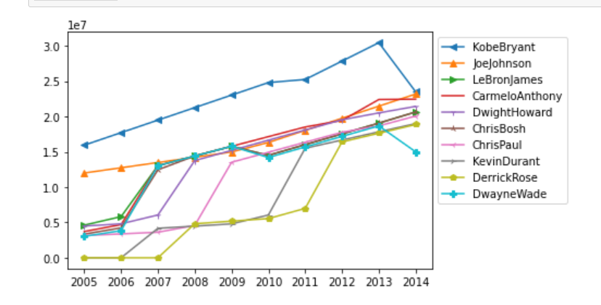
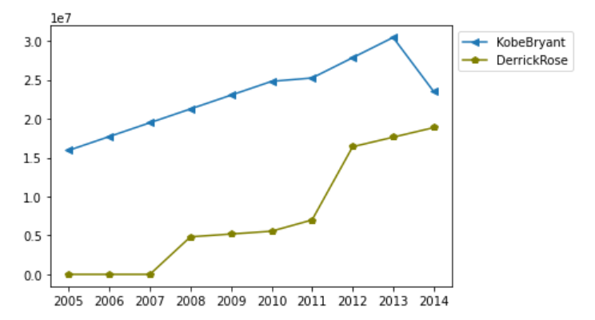
Which player earns max Salary and Vice versa?
Insights
Kobe Bryant has highest salary from past 10 year of data.
Derrick Rose has Lowest salary but it is increased over the time.
Derrick Rose Passed Dwayne Wade from 2013
Salary of All Players
High Salary player vs. Low Salary player

Slide 3
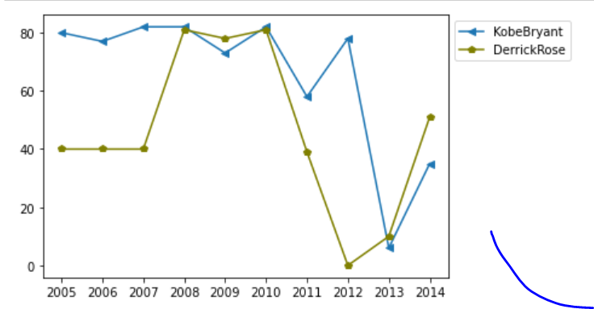
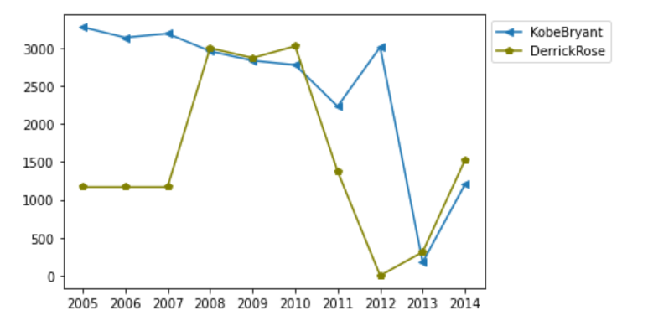
Games Played
Minutes Played
Insights:
Number of Games played by Kobe Bryant is more than Derrick Rose over the 10 years. Except from 2008 to 2010 and from 2013 to 2014.
Derrick Rose Played more minutes on than Kobe from 2008 to 2010 and from 2013 to 2014.

Slide 4
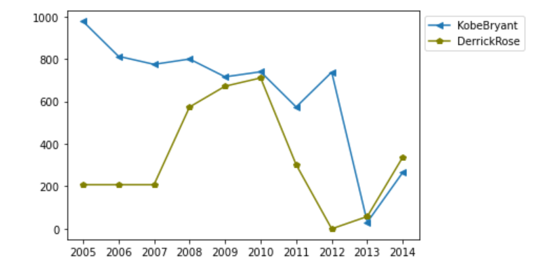

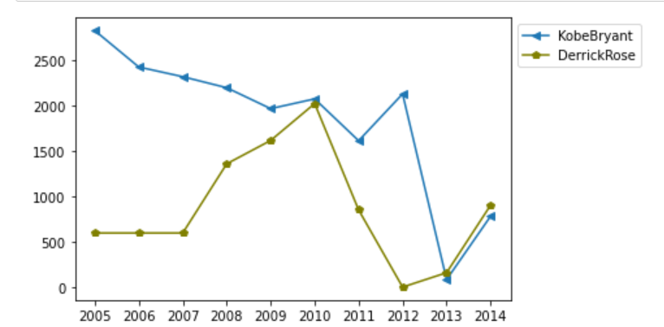
Field Goals
Field Goals Attempts
Insights:
Derrick Rose’s Field Goals, attempts and Points are All time lowers than Kobe from 2005 to 2013.
There is an improvement from 2013 in Derrick Rose performance.
Points

Slide 5
Thank you

